Slide 1
Mining statistics in psychology
Chris HJ Hartgerink
Tilburg university
Notes:
Hi! Many scientists use statistics and statistics are what gets reported in your papers. A trove of information all available in those research papers. But, just like meta-analyses answer questions across studies, mining these reported results allows us to meta-investigate statistics.

Slide 2
~30,000 papers
Notes:
For example, our research group gathered approximately 30,000 papers

Slide 3
~250,000 results
Notes:
And automatically extracted over 250,000 test results, which allowed us to answer various questions.

Slide 4
osf.io/gdr4q
Notes:
But because we are not almighty, we cannot foresee all the value in these data, so we made them publicly available. These data were limited to some very specific formats, so I am working on extending this.

Slide 5
Why?
Notes:
But why is building such a database important?

Slide 6
Why?
Data often not shared (62%)
Notes:
Because raw data are frequently not shared, but

Slide 7
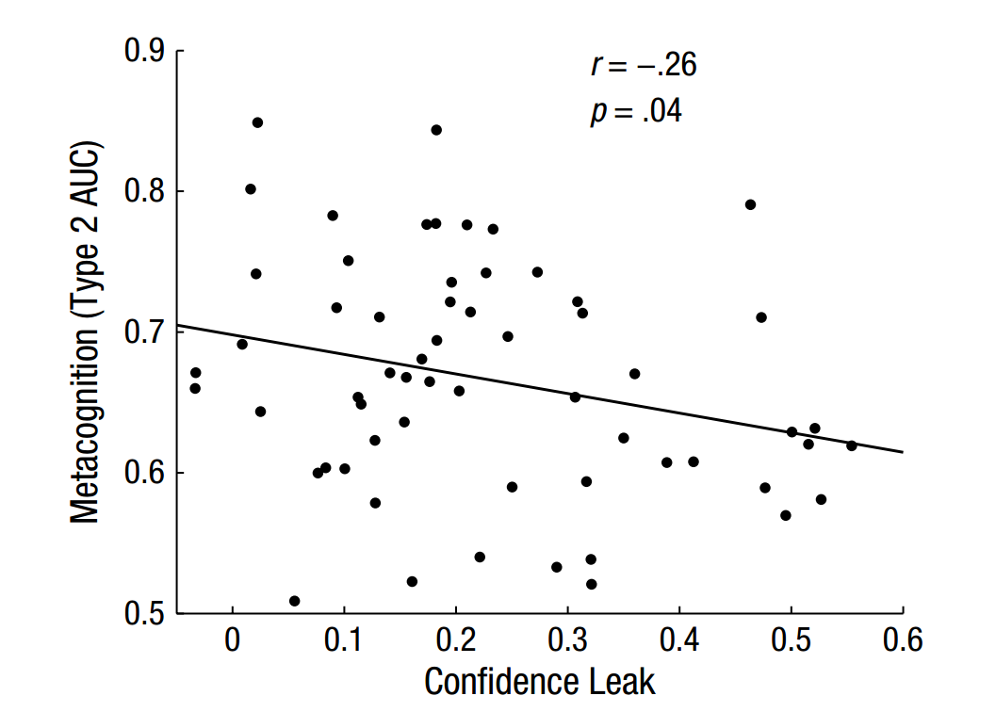

Rahnev et al., 2015
Notes:
Can be extracted from a paper. A scatterplot such as this one allows us to figure out the raw data underlying

Slide 8
Rahnev et al., 2015
Notes:
This result. Valuable information if you ask me and this is where the contentmine community helps to develop tools.

Slide 9
Why?
Data often not shared (62%)
1/8 papers significance error
Notes:
Many people make errors in their statistical results, which directly affects their conclusions. 1/8 papers in psychology showed at least one such an error!

Slide 10
F(1, 62) = 3.8, p < .05
Notes:
For example, this is what is reported (note that it is statistically significant)

Slide 11
F(1, 62) = 3.8, p < .05
p = .056
Notes:
But when we recalculate it, it is nonsignificant.

Slide 12
Why?
Data often not shared (62%)
1/8 papers significance error
Do the reported results indicate problems?
Notes:
And my project focuses on using the reported data to see whether there are potential problems, such as data fabrication.

Slide 13
Why?
Data often not shared (62%)
1/8 papers significance error
Do the reported results indicate problems?
Etc.
Notes:
Much more information is stored inside the papers, which is why building a database of information for psychology papers can be fruitful to answer many more research questions.

Slide 14
“You may [...] download [...] for scholarly use”
Sciencedirect terms and conditions

Slide 15
“you may not use [...] automated downloading [...] or equivalent manual processes”
Sciencedirect terms and conditions

Slide 16
@chartgerink chjh@protonmail.com chjh.nl
Notes:
Feel free to contact me at any and all of the above

